Slide 1


Viral VDAP
Viral alignment, Variant Discovery and Annotation Pipeline

Slide 2
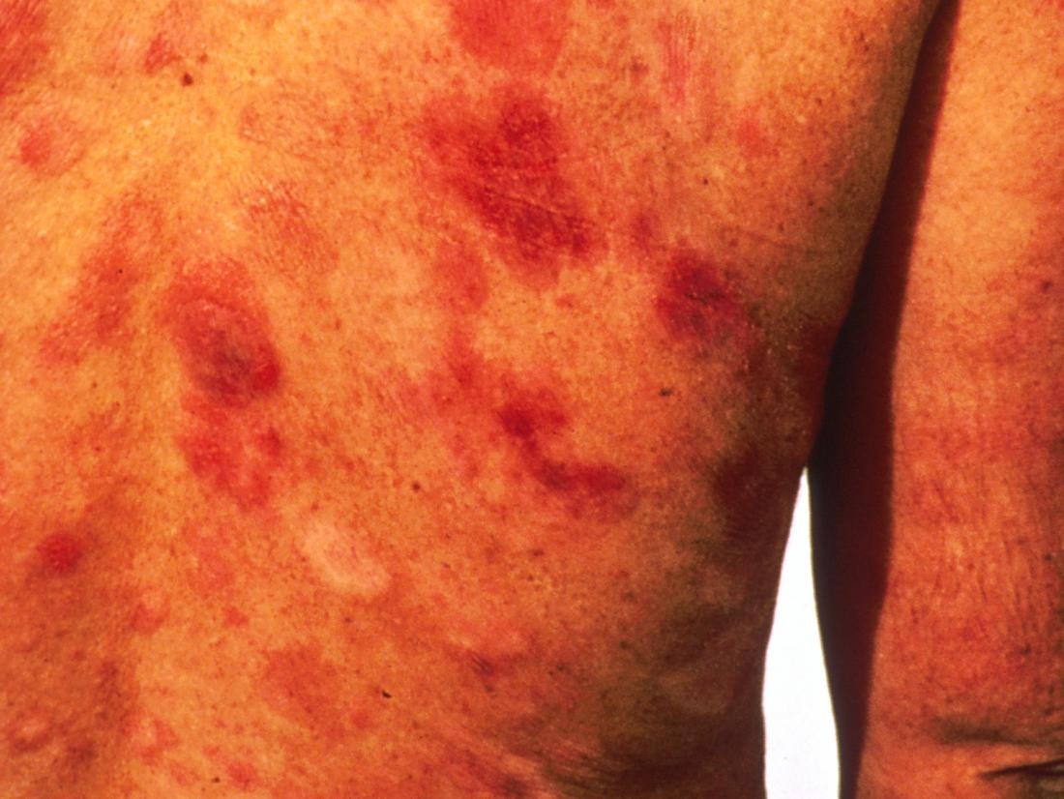
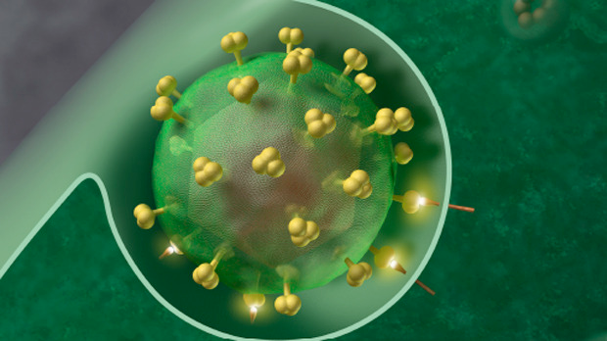
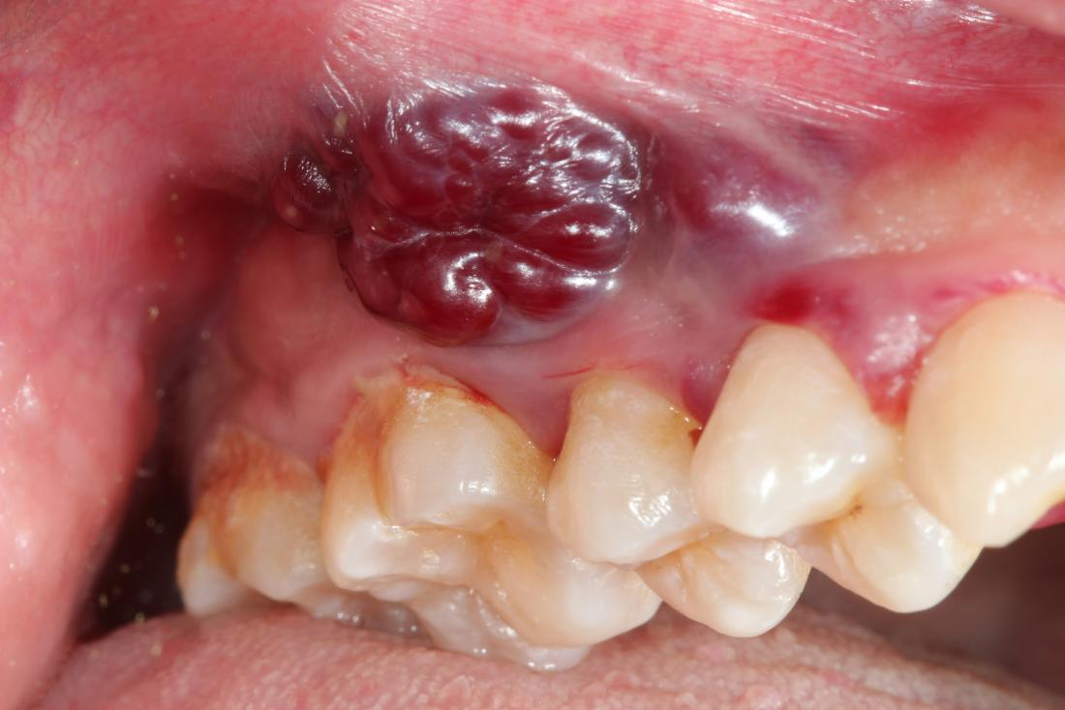

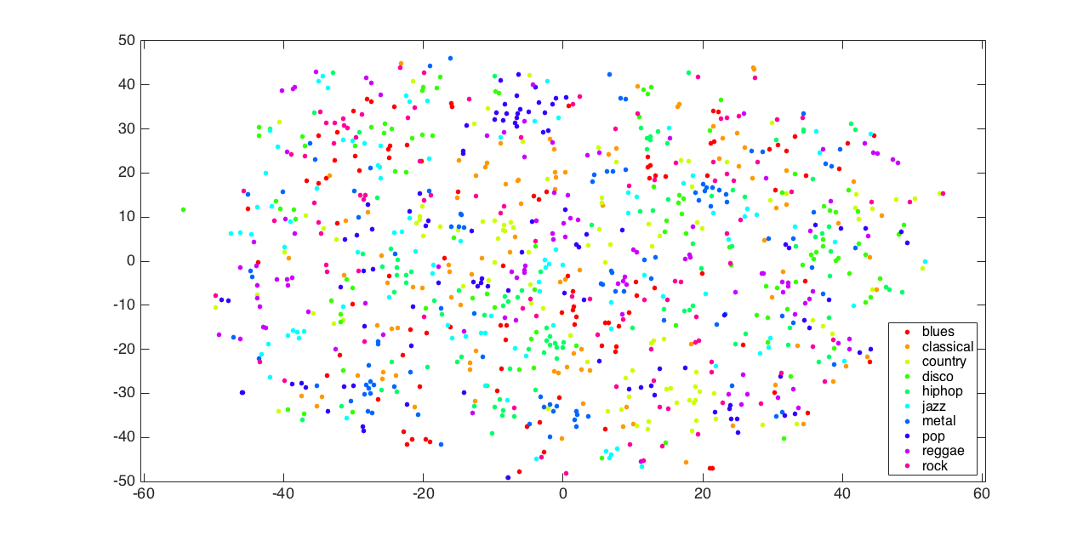
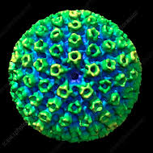
Why gammaherpesviruses?
Large genomes make analyses more difficult
Worldwide distribution, but genomic associations with pathogenicity have not been determined
Sparse dataset makes drawing conclusions tricky
Viruses contain human sequence, and human genomes contain virus sequence

Slide 3
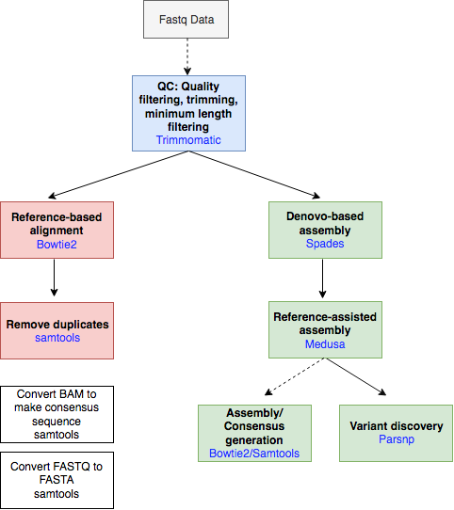
Input (KSHV):
GK18 (reference genome)
3 cell line datasets (corresponding genome sequences published

Slide 4
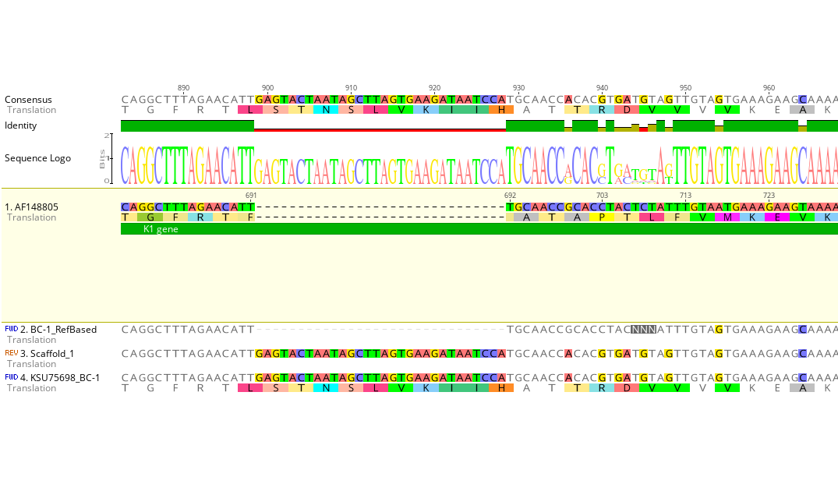
De novo performs better than reference-based alignment
- Variable regions

Slide 5
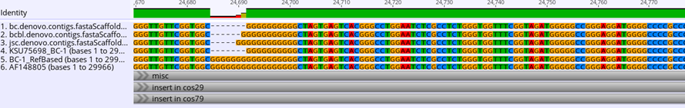
De novo performs better than reference-based alignment
- Short repeats

Slide 6
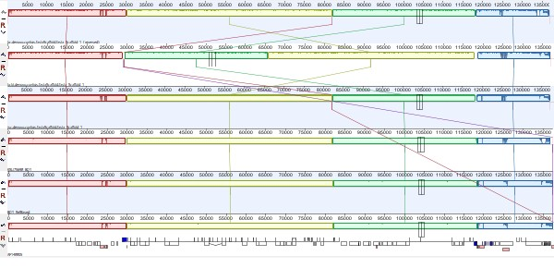
De novo allows identification of possible recombination events

Slide 7
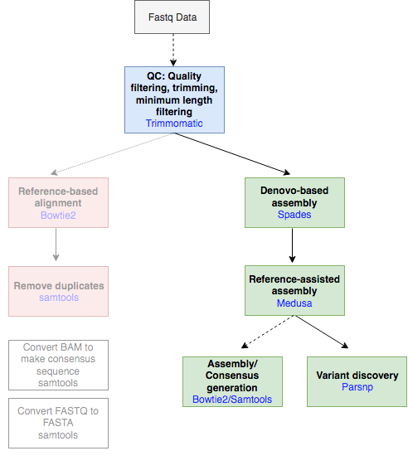
Things left to do:
Making it user accessible
(Snakemake & Docker)
Verify usage with more diverse sequences
(KSHV & other viruses)
Verify variant discovery and incorporate annotations

Slide 8
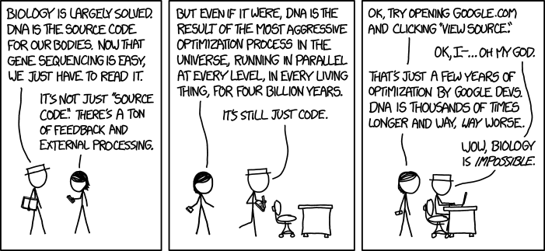
Elena Maria Cornejo Castro
Eneida Hatcher
Sasha Mushegian
Yunfan Fan
Sara Jones
Rashmi Naidu
Special thanks: Saba Nafees
Allissa Dillman

